Slide 1
IAM Program Development

Slide 2
Assess
Goal: form picture of current state in terms of SWOT
Environment Review
Existing policies, charters, objectives, etc.
Existing complementary programs:
Risk Management, 3rd Party Management, Compliance, IT
Potential stakeholders
business users, business owners, IT teams, audit/compliance teams, application owners/teams (integration)
Asset Inventory: hardware, applications, network resources
Prioritize by type, access requirements, etc.
Functionality Review
Identify existing IAM processes and tools
Identify current IAM roles and skills
group by specific project requirements or skills and experience

Slide 3
Form Program Planning Team
Goal: develop representative team to plan for best IAM approach
Team members based on stakeholder analysis
Business Team: Business Leaders, HR, Governance, Risk, …
Tech Team: Architecture, Application, Platform Admin, Process, …
Select a representative with good communication skills from each group
Determine IAM Executive Sponsor
Program champion with authority across all stakeholder areas
Determine IAM Program Manager(s)
Manages charter, roadmaps, priorities, program/project staffing
Guides vendor/partner/product procurement
Communicates IAM program’s current state, health, plans and priorities with the overall organization (preferably via an IAM portal)

Slide 4
Charter: Communicate Direction
Goal: communicate IAM Roadshow to stakeholders
Describe current environment along with risks and challenges (SWOT)
Convey how IAM can mitigate risks and addresses challenges
Convey business and user benefits, aligning to firm’s vision and values
Slight deeper dive into how it technically integrates with user data, applications, and storage, and user experience
Define the desired state – this could be the vision
Declare mission and objectives for IAM, and aligning them with firm’s business strategy, values and objectives
Roadmap specific IAM goals and outcomes within each of the phases
Plan, Design, Implement, Operate
Executive Sponsor / Program Manager to deliver communication FW

Slide 5
Charter: the What and Why
Goal: gain approach acceptance within a formal document
Start with clear, understandable explanation of what IAM is
Provide background of how we got here (from assessment SWOT)
Work through VMOST – Vision, Mission, Objectives, Strategy and Tactics
Vision can be similar to desired state and the benefits delivering firm values
Define 1-3yr goals aligned with firm’s initiatives and overall security objectives
Map goals to use cases and define success criteria for each, i.e.:
Identity Creation and Maintenance
Proof an Identity
Identity Lifecycle Management
Entitlement Lifecycle Management
Privileged Access Management

Slide 6
Charter: the Who and How
Goal: gain approach acceptance within a formal document
Define the different phases:
Planning, Design, Implement and Operate
Break down each phase into activities and milestones
Define the persistent team roles, i.e.:
IAM Executive Sponsor
Program Manager(s)
Project Manager(s)
IAM Architects
IAM Analysts
IAM Engineers
For each of the phase teams, define a RACI
Matrix mapping team members to activities and milestones
Members can be Responsible, Accountable, Consulted and/or Informed
Note: A persistent team should be involved in each IAM software product, from RFx through procurement, design, deployment and ongoing support

Slide 7
Program: Design Phase
Goal: Document an executable roadmap to implementation
Create a plan for standing up Program
Design phase to have three projects
Project: Governance
Define governance structure and committee
Develop a policy framework and documentation
Develop a risk assessment and management process
Define Performance measurement and reporting system
Project: Architecture
Create a prioritized roadmap and framework for implementing IAM modules
Tool selection to achieve desired state
Manage RFI, RFP, RFQ
Project: Processes
Determine operational processes
Develop staffing models based on the evaluation.
FTEs, Pro services, MSPs, contingent workers, etc.

Slide 8
Program: Implementation Phase
Goal: Implement IAM components in line with roadmap to desired state
Deploy the various IAM solutions and tools
Configure IAM policies and settings
Integrate IAM systems with the other infrastructure and applications
Train users and administrators
Identify the right individuals with required attitude and base skills
Enroll in hands-on trainings to groom employees into required roles
Mostly for the developer, support staff, analysts, etc.
Communicate all IAM changes and benefits to stakeholders
Use IAM portal documenting:
Real-time system status
Accomplishments
Current, long-term roadmap

Slide 9
Program: Operations Phase
Goal: Continuously improve and optimize operations and services
Monitor and measure results
Collect and analyzing data and feedback on:
IAM performance, effectiveness, and efficiency
Continually compare actual results with expected results
Identify any deviations or discrepancies
Monitor and respond to any changes or trends in:
Business environment, compliance requirements, or user behavior
Continually evaluate IAM impact and value
Report IAM achievements and challenges to stakeholders
Regularly review and update IAM policies, processes, tools, and roles
Implement any changes or enhancements that will improve IAM outcomes and stakeholder satisfaction

Slide 10
Michael von Ende
mvonende@redlegg.com

Slide 11
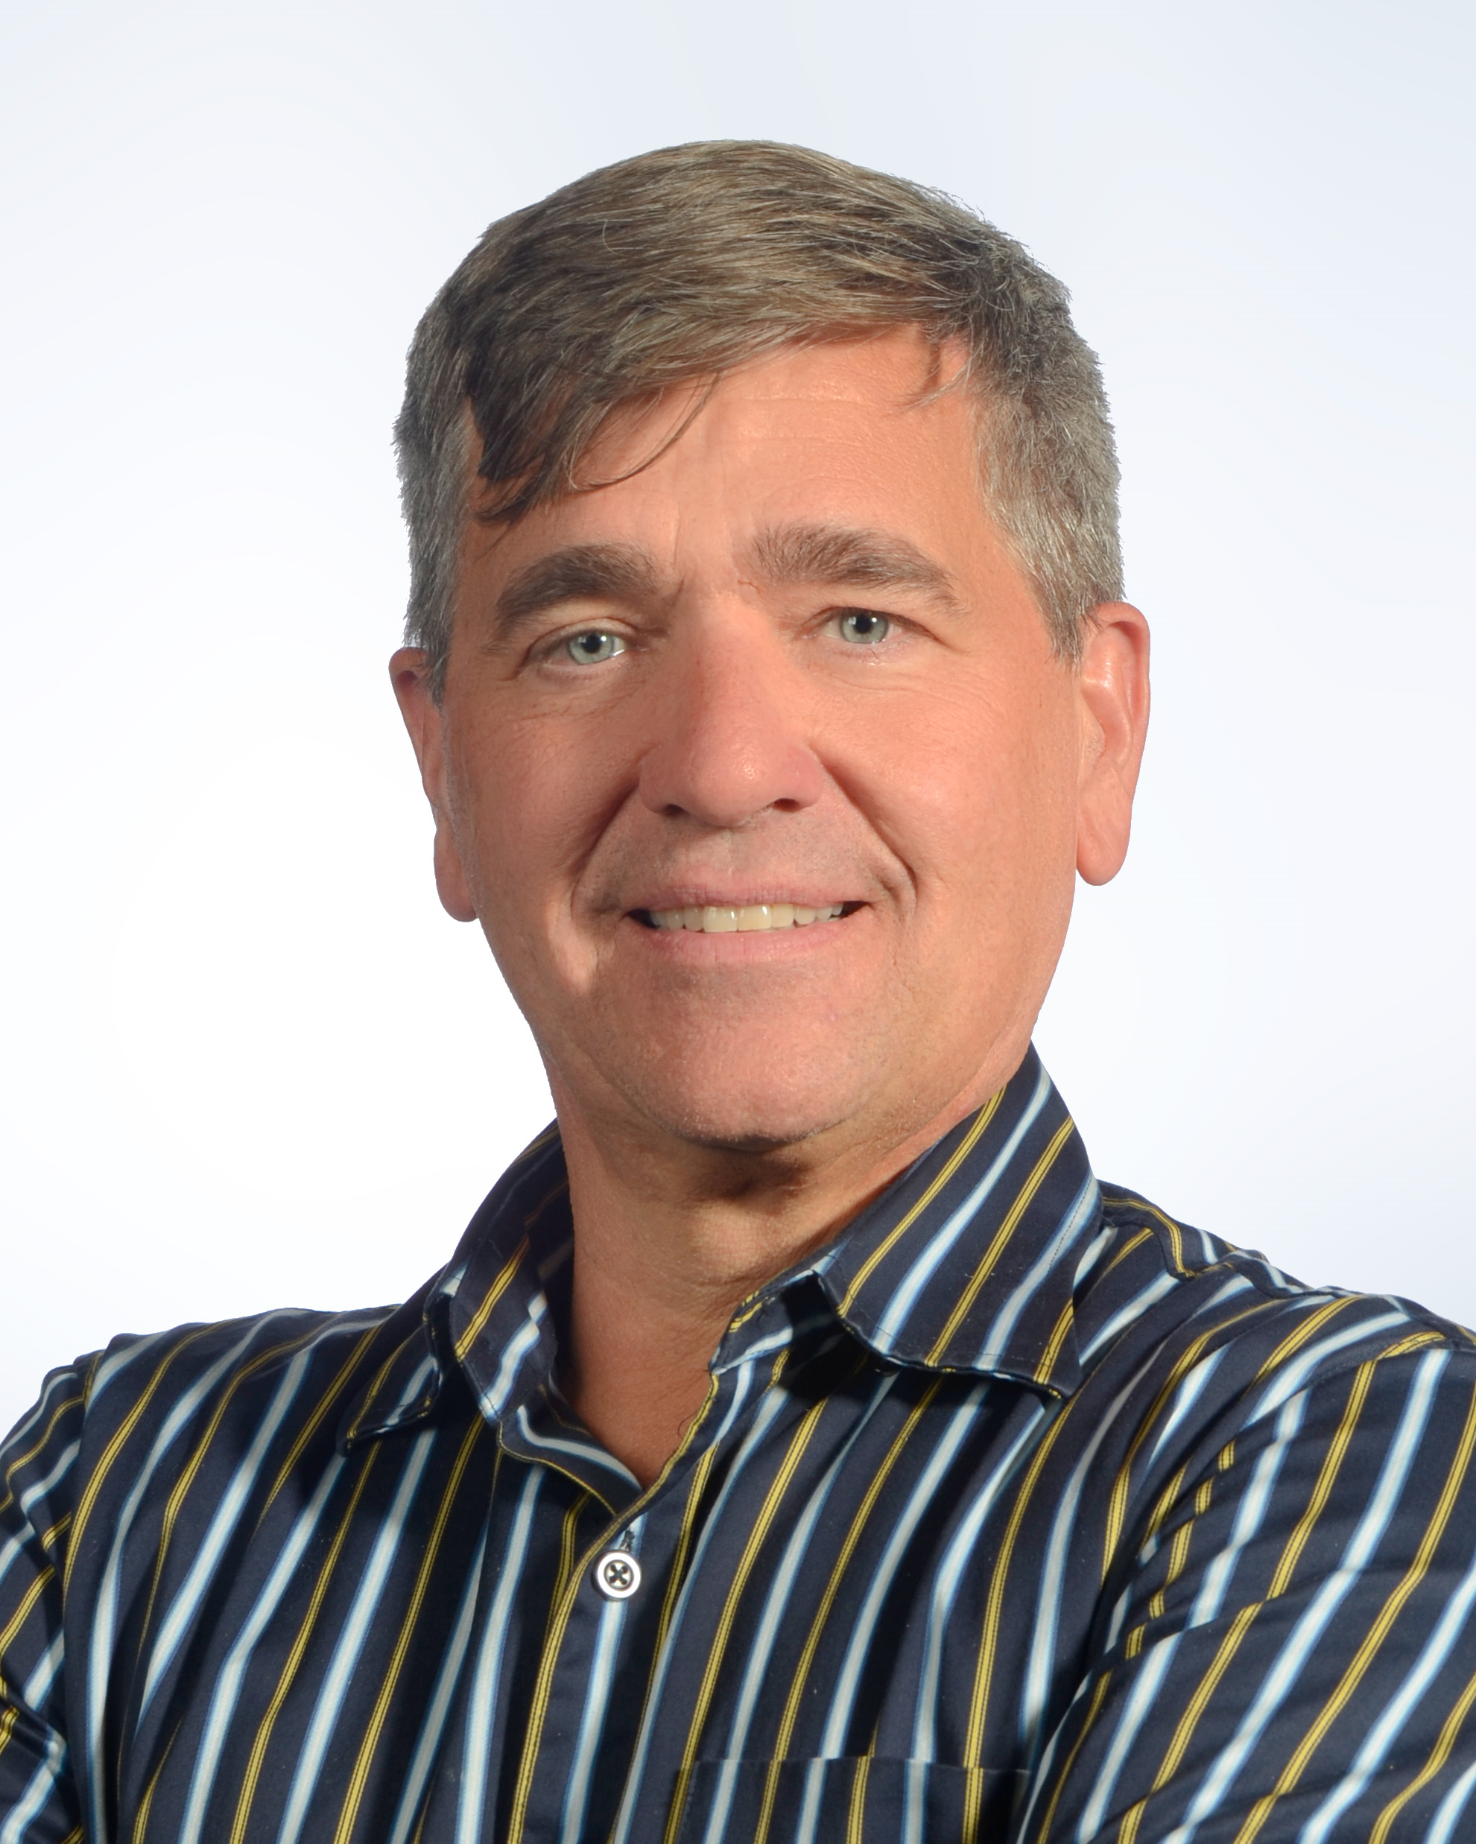
Michael von Ende
Senior Information Security Consultant
More than 20 years of business leadership and technical experience in Information Technology and Cybersecurity in four different countries.
Managed and consulted across various industries including financial, healthcare, telecommunications, engineering and manufacturing, consumer packaged goods, transportation and retail.
Practical experience with numerous frameworks and controls, including NIST CSF, 800-171, 800-53, CIS, DoD CCI, DISA STIG and HIPAA / HITRUST.
Leads security engagements into areas such as Compliance, Risk Management, Incident Response, BIA, BC/DR and IAM, and develops actionable, business-focused improvement plans.
Holds an MBA from McMaster University’s DeGroote School of Business and a B.Sc. in Computer Science Software Engineering.

